Slide 1

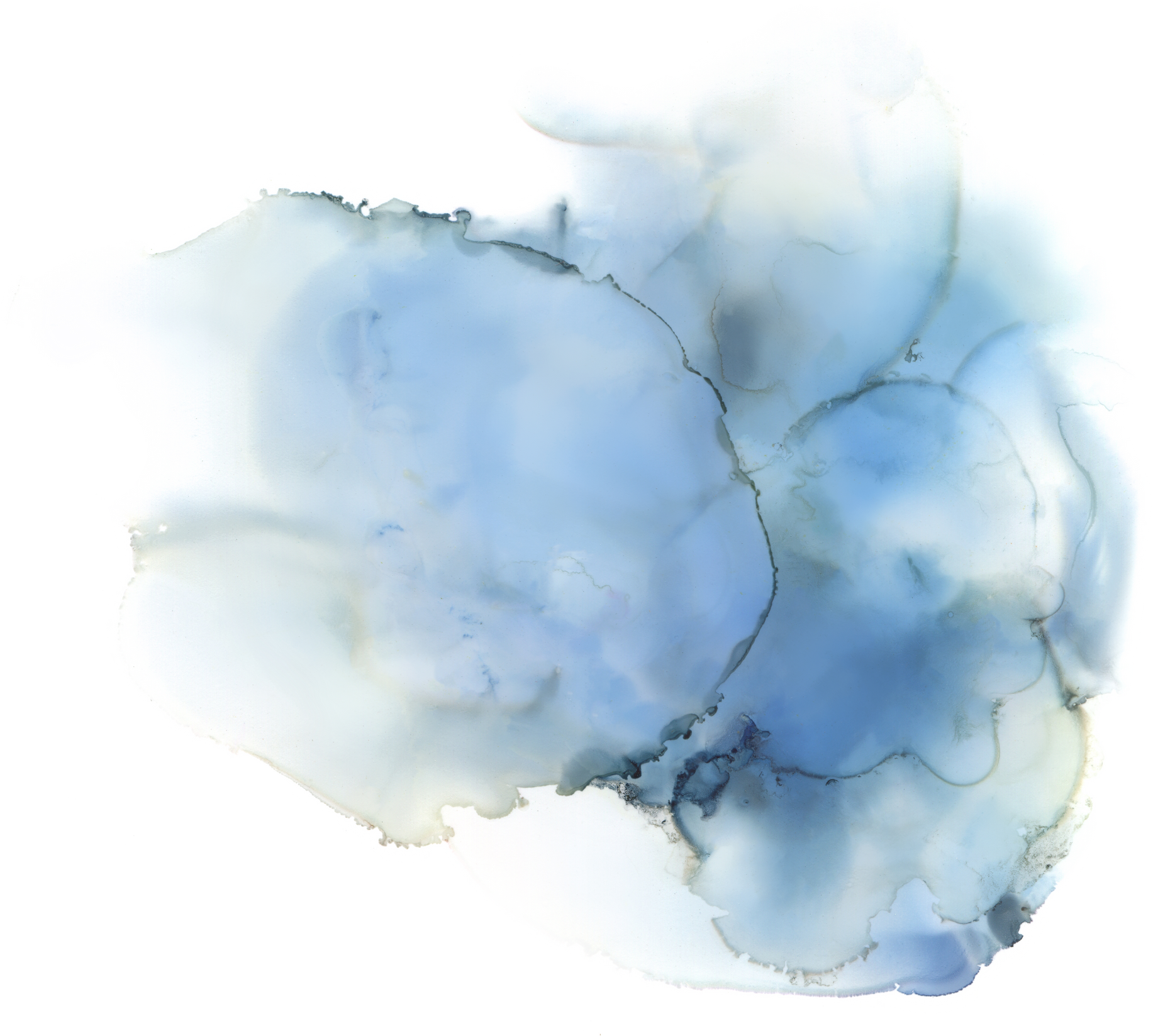


Team -20
COMPUTER GRAPHICS PROJECT
REAL TIME VOLUME RENDERING
WITH TRANSFER FUNCTION AND SHADING
Presented by Deepanshu Dabas (2021249)

Slide 2
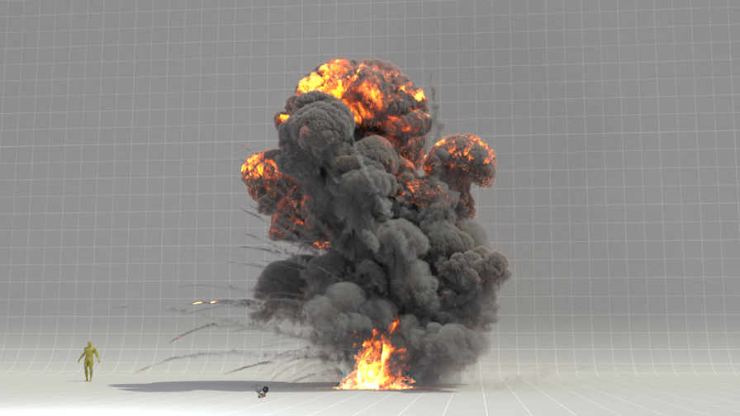
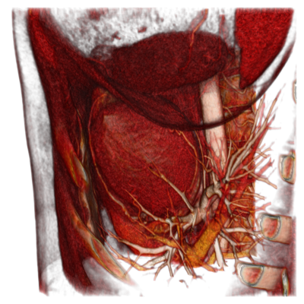

About Volume Rendering
Fig 1: Explosion Effect
Fig 2: Heart Visualisation
Volume rendering represents a collection of methods used in computer graphics and scientific visualization to create a 2D projection from a discretely sampled data set.
Source : Delight Cloud , Atomicus Chart

Slide 3
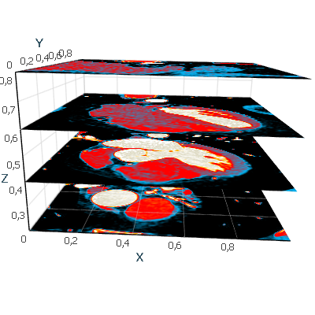
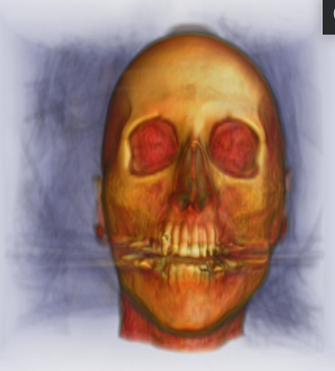
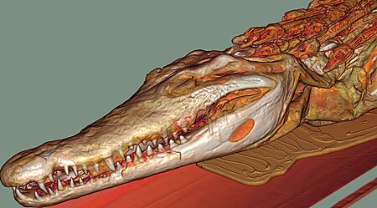
Use Case: Scientifc Visualization
Volume rendering in scientific visualization enables the analysis and exploration of complex data sets, generated by X-rays and CT-Scans,etc
Source: Wikipedia , Atomicus Chart

Slide 4
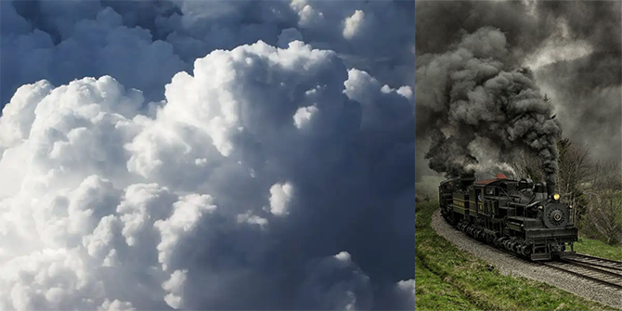
Use Case: Computer Graphics
Volume rendering can produce realistic and/or observable reprentations of volumetric phenomena, such as clouds, fog, smoke, fire, etc. by modeling the interaction of light with the medium inside the volume
Source: Scratch Pixel

Slide 5

Why Volume Ray Casting?
Image Based Volume Rendering
Derived directly from the rendering equation.
Produces results of very high quality rendering.
Simulated rays are traversed iteratively,
Often used in cases where creating explicit geometry is not a good option.. Example: Triangles

Slide 6
Steps For Volume Rendering
Ray Casting: Shoot a ray through the volume for each pixel of using a bounding primitive to intersect the ray with the volume.
Sampling: Select equidistant sampling points along the ray within the volume, interpolating values from surrounding voxels using trilinear interpolation1.
Shading: Apply a transfer function to retrieve RGBA material color and compute a gradient of illumination values for each sample, shading them according to their orientation and light source location2
Compositing: Composite shaded samples along the ray to determine the final pixel color, using either back-to-front or front-to-back order to ensure proper layering and efficiency.

Slide 7
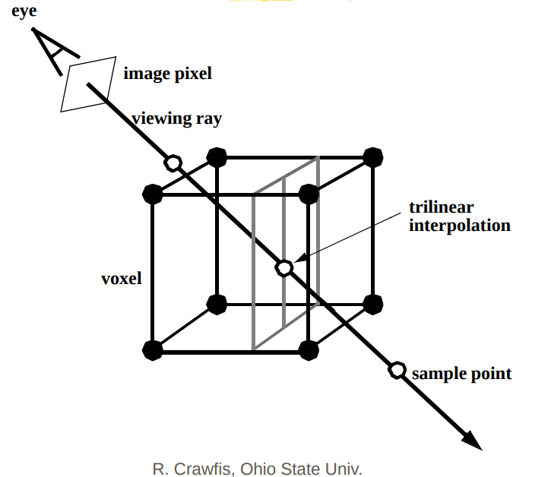
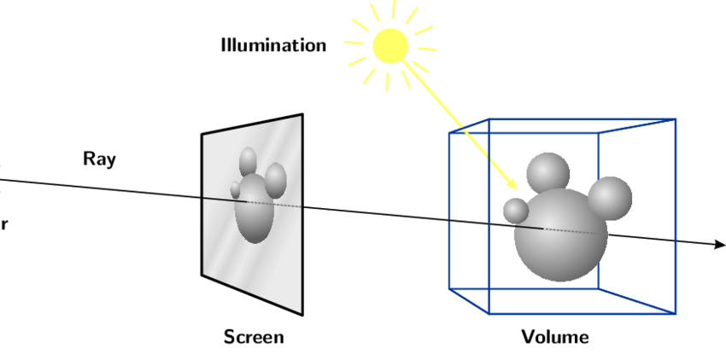
Steps For Volume Rendering

Slide 8
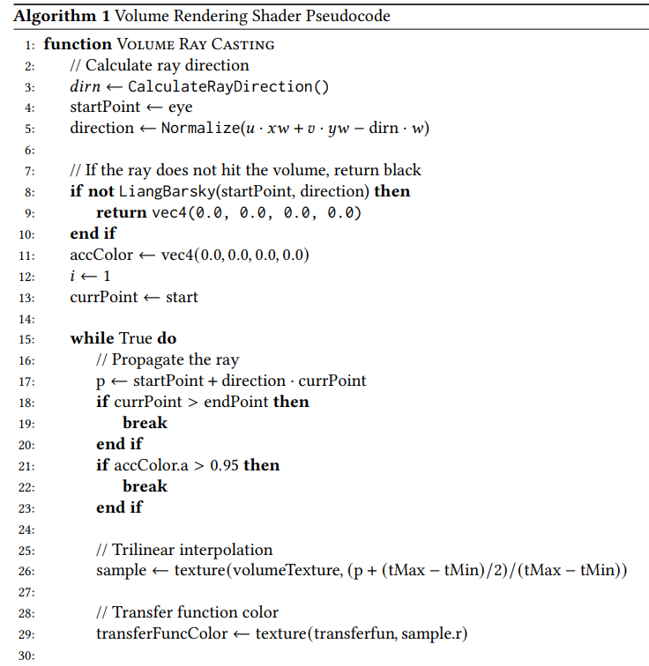
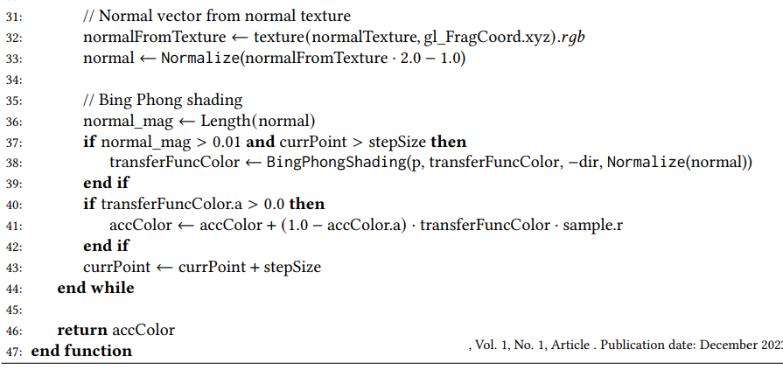
Pseudo Code : Volume Ray Casting
Note:
For tri-linear interpolation ,3 D texture is used along with filltering method Mipmapping
Early Ray termination based optimization is performed
Normals for shading are calculated using central difference method
Front to back composition is performed for better optimization

Slide 9
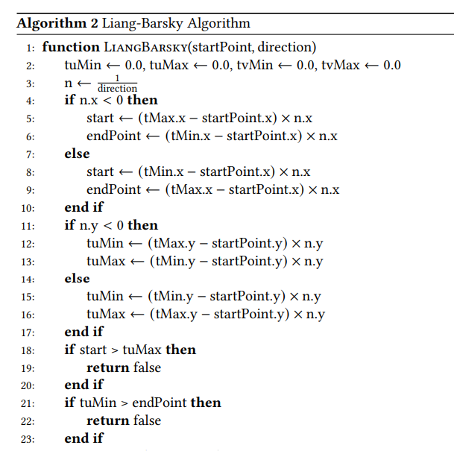
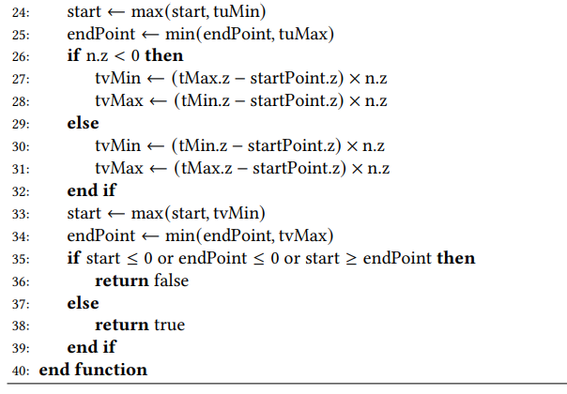
Pseudo Code : Liang-Barsky Algo

Slide 10
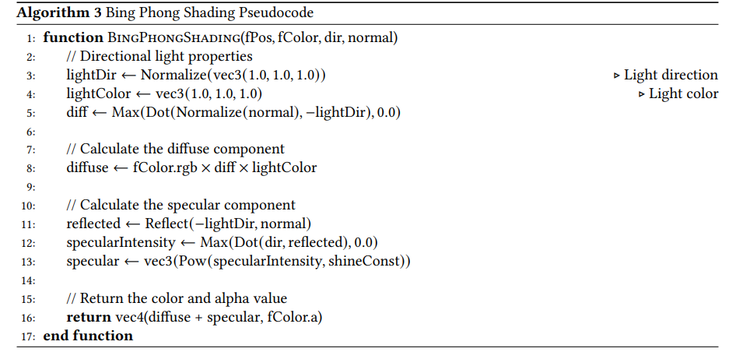
Pseudo Code : Bing-Phong Shading

Slide 11
Tech Stack Used
OpenGL
ImGui
glfw
glm
Cmake
Make

Slide 12
Outcomes
Volumetric Rendering Techniques: Explored methods for creating 3D images from volumetric data, crucial in fields like medical imaging and special effects.
Transfer Functions: Investigated the use of transfer functions in rendering to differentiate materials within a volume, enhancing image accuracy and utility.
Real-Time Rendering: Implemented real-time volume rendering using graphics hardware acceleration, optimizing performance through techniques like early ray termination.
Shading and Composition: Applied surface shading and composition algorithms to add realism to the images and accurately represent 3D volumetric data.
Learned more about OpenGL and gl_shaders and overall improved understanding of computer graphics

Slide 13

Additional Features
Edit Transfer Functions
Load/Save Transfer Function
Transformations
Change Volume
User can edit transfer function values using color paletter provided as input
User can load pre exisitng transfrer fiunctions as well as save current by specifying name of Output file
Rotation, View Transformations,,etc
Need to just Add dataset to visualise in Data folder

Slide 14
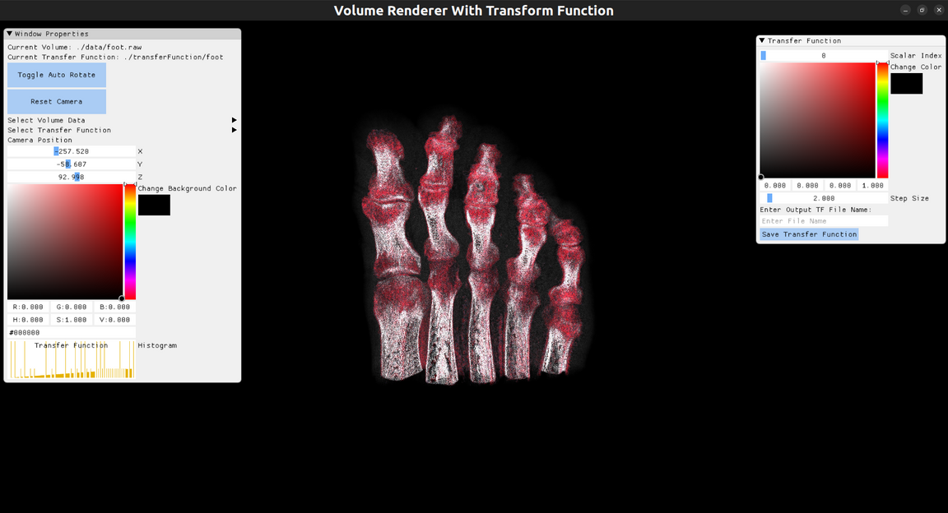
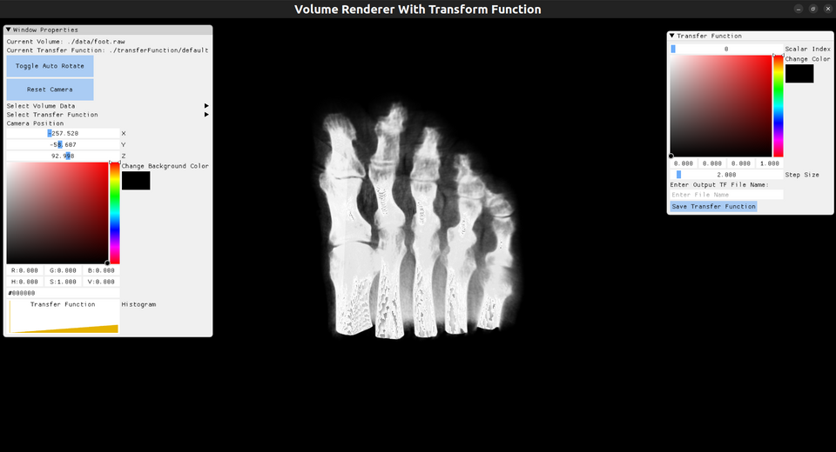
Output Images
GrayScale Based Transfer Function
Foot-Custom Transfer Function

Slide 15
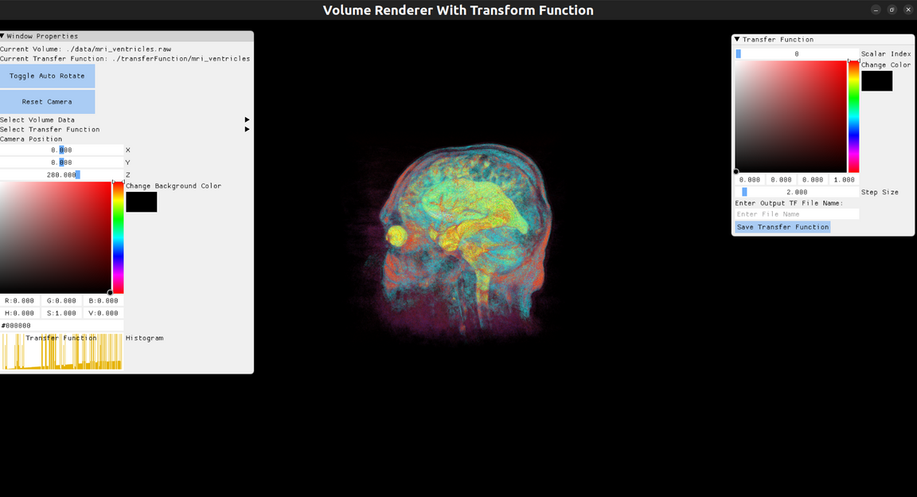
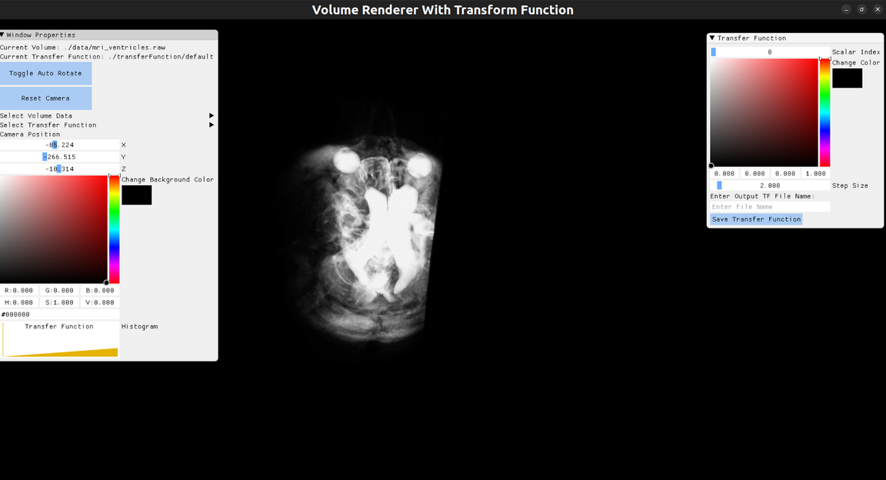
Output Images
GrayScale Based Transfer Function
MRI--Custom Transfer Function

Slide 16
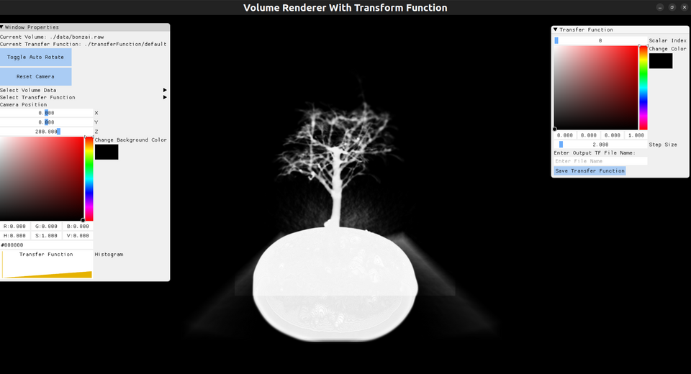
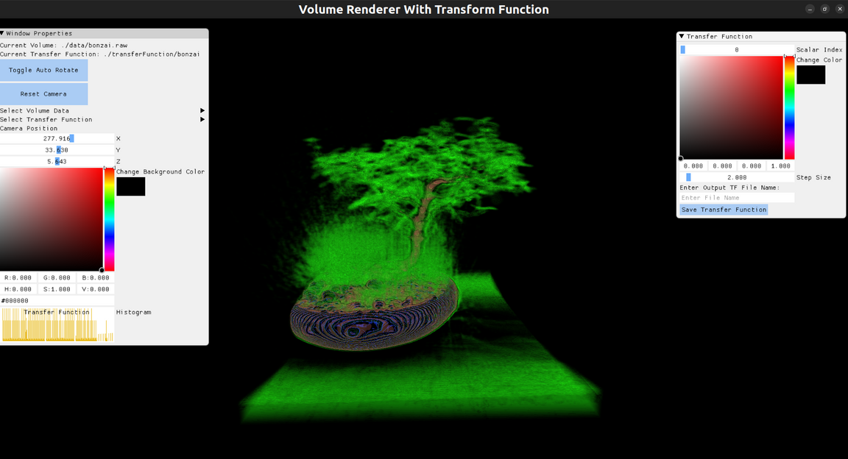
Output Images
GrayScale Based Transfer Function
Bonzai--Custom Transfer Function

Slide 17
﻿THANK YOU
Team 20, Deepanshu Dabas, 2021249

